Slide 1

ITT440 NETWORK PROGRAMMING
Python Socket Programming

Slide 2

Basic Knowledge
Python provides two levels of access to network services.
At a low level, you can access the basic socket support in the underlying operating system, which allows you to implement clients and servers for both connection-oriented and connectionless protocols.
Python also has libraries that provide higher-level access to specific application-level network protocols, such as FTP, HTTP, and so on.

Slide 3
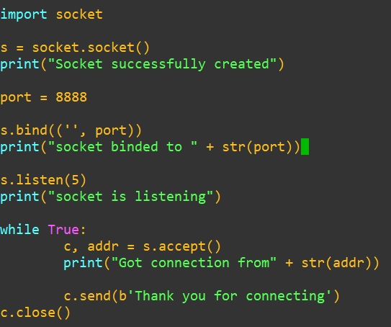
server-tcp.py

Slide 4
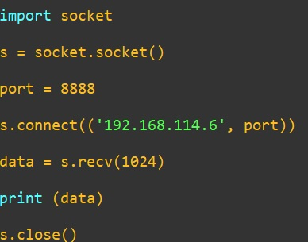
client-tcp.py

Slide 5
Exercises
By using Python programming please create:
UDP time server and client that connect through port 22000.
A program using port 27679 TCP that passing multiple random numbers.
A UDP client-server port 11235 that passing Fibonacci series based on input from client where follow the following criteria:
x_{n} is term number "n"
The client must provide n.
The server must send term and onwards of five sequence.
The client can choose either want another five sequence or quit the program.
The server must continue send another five sequence onward of last term provided if ask to do so by the client.

Slide 6
References
Google
Youtube
eBook

